Slide 1
MOBILE WIDE AREA NETWORKS

Slide 2
Wireless WAN is a wide area network in which separate areas of coverage or cells are connected wirelessly to provide service to a large geographic area.
WWAN services are typically delivered to smart phones and other handheld devices

Slide 3
The Electromagnetic Spectrum
When electrons move, they create electromagnetic waves that can propagate through space (even in a vacuum).
The number of oscillations per second of a wave is called its frequency, f, and is measured in Hz
The distance between two consecutive maxima (or minima) is called the wavelength

Slide 4
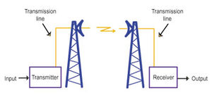
When an antenna of the appropriate size is attached to an electrical circuit, the electromagnetic waves can be broadcast efficiently and received by a receiver some distance away. All wireless communication is based on this principle

Slide 5
In a vacuum, all electromagnetic waves travel at the same speed, no matter what their frequency. This speed, usually called the speed of light, c, is approximately 3 × 108 m/sec
The fundamental relation between f, λ, and c (in a vacuum) is c = fλ
C – Speed f – Frequency λ -Wavelength

Slide 6
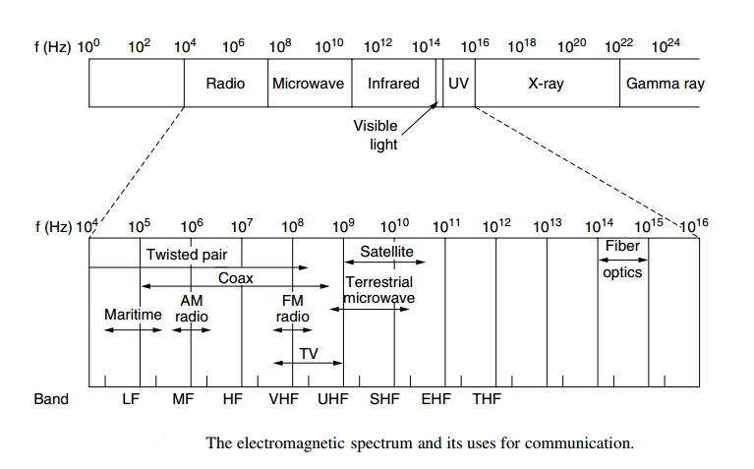

Slide 7
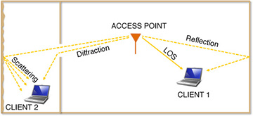
Wireless signal propagation
In a wireless communication system, a transmitted signal can reach the receiver via a number of propagation mechanism.

Slide 8
The LOS path is unobstructed between the access point and client 1.
That client also receives weaker signals as a result of a reflection off of a wall.
The LOS path is obstructed for client 2, who instead receives signals through diffraction in the doorway and also scattering off of a rough wall.

Slide 9
Line of Sight (LOS)
When a signal reaches the receiver from the transmitter in a single path, without suffering any reflections, diffractions, or scattering, this is known as propagation along the line-of-sight (LOS) path
LOS component has the shortest time delay among all the received signals and is usually the strongest signal received

Slide 10
In non-line-of-sight (NLOS) propagation, a signal transmitted into a wireless medium reaches the receiver via one or more indirect paths, each having different attenuations and delays.
When a transmitted signal travels through communication paths other than the LOS path to reach the receiver, it is said to have undergone NLOS propagation

Slide 11
NLOS propagation mechanisms
Reflection
Scattering
Diffraction.

Slide 12
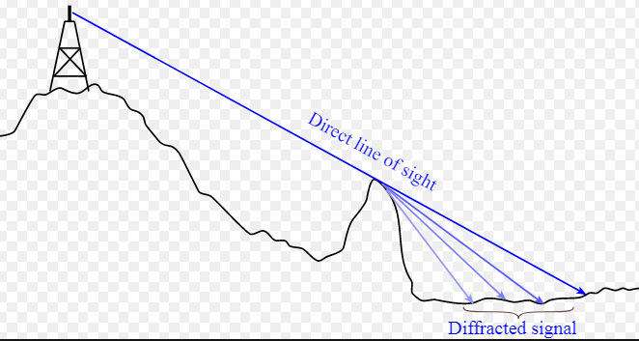
Diffraction of electro magnetic wabe

Slide 13
Wireless Impairements
When the received signal is not as same as the transmitted signal then it is known as Transmission impairment. In wireless communication impairment takes place due to various causes such as - Path Loss - Multipath Propagation - Co-channel interference - Fading - Doppler effects

Slide 14
Path Loss
Electromagnetic radiation attenuates as it passes through matter.
Even in free space, the signal will disperse, resulting in decreased signal strength as the distance between sender and receiver increases.

Slide 15
Multipath Propagation
Multipath propagation occurs when portions of the electromagnetic wave reflect off objects and the ground, taking paths of different lengths between a sender and receiver.
This results in the blurring of the received signal at the receiver.
Moving objects between the sender and receiver can cause multipath propagation to change over time

Slide 16
Co-channel Interference
Radio sources transmitting in the same frequency band will interfere with each other.
The time variation of received signal power due to changes in transmission medium or paths is known as fading
Fading

Slide 17
CDMA
Code Division Multiple Access (CDMA) is a channel access method normally used by 3G radio communication technology as well as in some other technologies.
Code Division Multiple Access (CDMA) is a digital cellular technology used for mobile communication.

Slide 18
CDMA is the base on which access methods such as cdmaOne, CDMA2000, and WCDMA are built.
CDMA cellular systems are deemed superior to FDMA and TDMA, which is why CDMA plays a critical role in building efficient, robust, and secure radio communication systems.
Notes:
Let’s take a simple analogy to understand the concept of CDMA. Assume we have a few students gathered in a classroom who would like to talk to each other simultaneously. Nothing would be audible if everyone starts speaking at the same time. Either they must take turns to speak or use different languages to communicate.
The second option is quite similar to CDMA — students speaking the same language can understand each other, while other languages are perceived as noise and rejected. Similarly, in radio CDMA, each group of users is given a shared code. Many codes occupy the same channel, but only those users associated with a particular code can communicate

Slide 19
CDMA - Features
In CDMA, every channel uses the full available spectrum.
Individual conversations are encoded with a pseudo-random digital sequence and then transmitted using a wide frequency range.
CDMA consistently provides better capacity for voice and data communications, allowing more subscribers to connect at any given time.
CDMA is the common platform on which 3G technologies are built

Slide 20
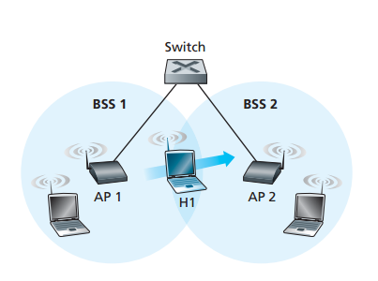
Mobility within the same IP subnet

Slide 21
Figure shows two interconnected BSSs with a host, H1, moving from BSS1 to BSS2
when H1 moves from BSS1 to BSS2, it may keep its IP address and all of its ongoing TCP connections since the subnet is the same.
If H1 is moving toa different subnet, it should be provided with a ne wIP address where TCP connections will be terminated.

Slide 22
As H1 wanders away from AP1, H1 detects a weakening signal from AP1 and starts to scan for a stronger signal.
When H1 receives beacon frames from AP2. H1 then disassociates with AP1 and associates with AP2, while keeping its IP address and maintaining its ongoing TCP sessions.
This addresses the handoff problem from the host and AP viewpoint

Slide 23
What is Hand Off in communication?
When a mobile user travels from one area of coverage or cell to another cell within a call’s duration the call should be transferred to the new cell’s base station. Otherwise, the call will be dropped because the link with the current base station becomes too weak as the mobile recedes. Indeed, this ability for transference is a design matter in mobile cellular system design and is call handoff.

Slide 24
Switches are “self-learning” and automatically build their forwarding tables.
If H1 is initially in BSS1, then a datagram destined to H1 will be directed to H1 via AP1. Once H1 associates with BSS2, however, its frames should be directed to AP2
AP2 sends a broadcast Ethernet frame with H1’s source address to the switch just after the new association.
When the switch receives the frame, it updates its forwarding table, allowing H1 to be reached via AP2

Slide 25
Mobile IP
Mobile IP enables an IP node to retain the same IP Address and maintain existing communications while traveling from one link to another.
Mobile IP is designed to allow mobile devices users to move from one network to another while maintaining a permanent IP address

Slide 26
Mobile Node (MN)
The mobile Node is a device such as
A cell phone
PDA
or Laptop
Whose software enables network roaming capabilities.

Slide 27
Home Agent (HA)
Home agent is a router on the home network serving as the anchor point for communication with the mobile node.
It tunnels packets from a device on the internet, called a Correspondent Node to the roaming Mobile node. (A tunnel is established between the HA and a reachable point for the mobile node in the foreign network)

Slide 28
Correspondent Node
Foreign Agent (FA)
The foreign agent is a router that may function as the point of attachment for the mobile node when it roams to a foreign network, delivering packets from the home agent to the mobile node.
End host to which MN is corresponding.

Slide 29
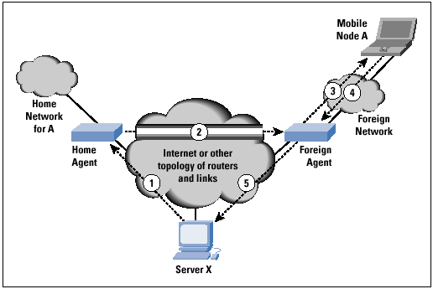

Slide 30
Every site that wants to allow its users to roam has to create a helper at the site called a home agent.
When a mobile host shows up at a foreign site, it obtains a new IP address (called a care-of address) at the foreign site.
The mobile then tells the home agent where it is now by giving it the care-of address. When a packet for the mobile arrives at the home site and the mobile is elsewhere, the home agent grabs the packet and tunnels it to the mobile at the current care-of address.
The mobile can send reply packets directly to whoever it is communicating with, but still using its home address as the source address.

Slide 31
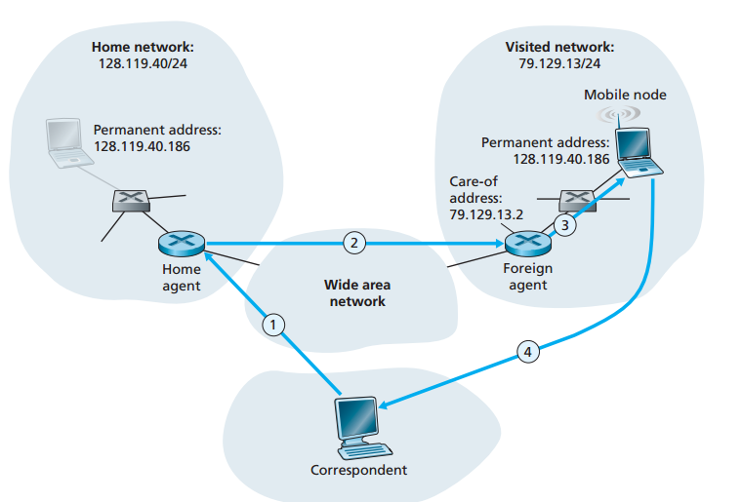

Slide 32
How Mobile IP Works
Agent Discovery A MN discovers its foreign and home agents during agent discovery
Registration A MN now registers its current location with the foreign agent and home agent
Tunneling A tunnel is setup by the home agent to the care of address (Current location of the mobile node on the foreign network) to route packets to the mobile node as it roams.

Slide 33
Wireless Broadband
Wireless broadband is high-speed Internet and data service delivered through a wireless local area network (WLAN) or wide area network (WWAN).
IEEE 802.16

